Slide 1
Shareholder Presentation
November 2016

Slide 2
Disclaimer
  This presentation has been prepared for use in conjunction with a verbal presentation and should be read in that context. The information in this presentation is only intended for Australian residents. The purpose of this presentation is to provide information only and the contents of the presentation does not purport to provide investment advice. We strongly suggest that investors read the Prospectus and consult a financial adviser prior to making any investment decision. The presentation does not take into account the investment objectives, financial situation or particular needs of any person and should not be used as the basis for making investment, financial or other decisions. The information is selective and may not be complete or accurate for your particular purposes and should not be construed as a recommendation to invest in Future Generation Investment Company Limited or Future Generation Global Investment Company Limited. The information provided in the presentation is given in good faith and is believed to be accurate at the time of compilation. Neither Future Generation Investment Company Limited, Future Generation Global Investment Company Limited nor its directors or employees make any representation or warranty as to the accuracy, reliability, timeliness or completeness of the information. To the extent permissible by law, Future Generation Investment Company Limited, Future Generation Global Investment Company Limited and its directors and employees disclaim all liability (whether arising in contract, tort, negligence or otherwise) for any error, omission, loss or damage (whether direct, indirect, consequential or otherwise). Neither Future Generation Investment Company Limited, Future Generation Global Investment Company Limited nor its directors or employees guarantee or make any representation as to the performance of Future Generation Investment Company Limited, Future Generation Global Investment Company Limited, the maintenance or repayment of capital, the price at which shares may trade or any particular rate of return.

Slide 3

Our purpose
Australia’s
first listed philanthropic wealth creation vehicles
Prominent domestic (FGX) & global (FGG) fund managers who act pro bono
1% of net assets p.a.
donated to youth at
risk & youth mental health

Slide 4
Investment objectives
1
2
3
    Stream of
    fully franked dividends
    Achieve
    capital growth
      Preserve shareholder capital
ALLOCATION
  Long equities
  Quantitative strategies
  Absolute bias
  Market neutral

Slide 5

New developments
YEAR END
No brokerage fees
Change to
31 December

Slide 7





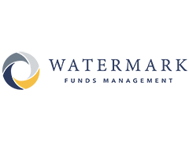













FGX fund managers

Slide 8














FGX charities

Slide 9







FGX service providers

Slide 10

FGX performance

Slide 11

FGX highlights
    $2.29m
    donation
    to Australian charities
    Savings
    of $6.28m
    Delivered from pro-bono management, performance & services
    Fully franked
    4.0 cents
    per share full year dividend
    18.2% increase
    in pre-tax profit to $17.75 million

Slide 12
FGX outperformance
Performance at 31 October 2016 | 6 MONTH % | 1 YEAR % | 2 YEAR % | Since inception September 2014 (% pa)
FGX | 6.3% | 9.1% | 10.2% | 9.1%
S&P/ASX All Ordinaries Accumulation Index | 3.8% | 6.6% | 3.5% | 2.7%
Outperformance | +2.5% | +2.5% | +6.7% | +6.4%

Slide 13



FGX Net Tangible Assets as at 31 October 2016
NTA after tax
& before tax on unrealised gains
113.20c*
NTA before tax
113.57c
NTA after tax
112.98c*
*These figures are after the tax payment of $56k (0.01 cents per share) in tax during the month.

Slide 14
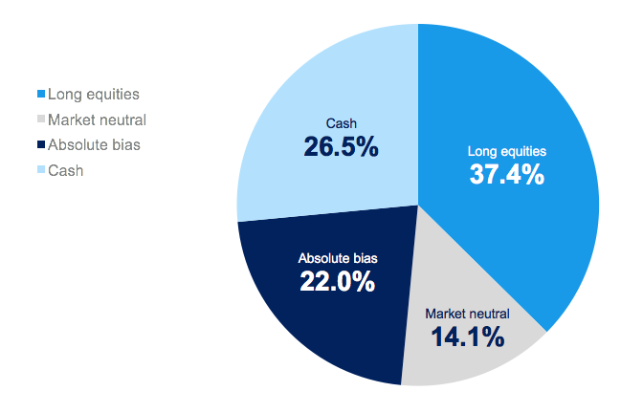
FGX investment strategy allocation

Slide 15
FGX allocation at 31 October 2016
Fund manager | Investment | Strategy | % of assets
Regal Funds Management | Regal Australian Long Short Equity Fund | Long equities | 9.0%
Wilson Asset Management (International) | Wilson Asset Management Equity Fund | Absolute bias | 8.5%
Watermark Funds Management | Watermark Absolute Return Fund | Market neutral | 7.5%
 | Large/Mid Cap Funds (split out below) |  | 7.0%
Paradice Investment | Paradice Australian Equities Mid Cap Fund | Long equities | 3.9%
 | Paradice Large Cap Fund | Long equities | 3.1%
Bennelong Australian Equities Partners | Bennelong Australian Equities Fund | Long equities | 6.5%
Eley Griffiths Group | Eley Griffiths Group Small Companies Fund | Long equities | 5.4%
Tribeca Investment Partners | Tribeca Alpha Plus Fund | Absolute bias | 4.6%
Sandon Capital | Sandon Capital Activist Fund | Absolute bias | 4.1%
Cooper Investors | Cooper Investors Australian Equities Fund | Long equities | 3.3%
Bennelong Long Short Equity Management | Bennelong Long Short Equity Fund | Market neutral | 3.1%
Optimal Fund Management Australia | Optimal Australia Absolute Trust | Market neutral | 2.9%
CBG Asset Management | CBG Asset Australian Equities Fund | Long equities | 2.4%
Discovery Asset Management | Discovery Australian Small Companies Fund | Long equities | 2.2%
LHC Capital | LHC Capital Australia High Conviction Fund | Absolute bias | 2.0%
Centennial Asset Management | The Level 18 Fund | Absolute bias | 1.7%
Smallco Investment Manager | Smallco Broadcap Fund | Long equities | 1.6%
Lanyon Asset Management | Lanyon Australian Value Fund | Absolute bias | 1.1%
Qato Capital | Qato Capital Market Neutral L/S Fund | Market neutral | 0.6%
 | Cash and Term Deposits | Cash | 26.5%

Slide 16


FGX options
$179,768,729
RAISED
89.9%
OPTIONS EXERCISED
163,426,117
TOTAL OPTIONS

Slide 17






FY16
FGX impact on children and youth at risk
 | Therapy services for almost 100 neglected and abused children |  |  |  | Two specialised nurses employed in to meet family needs in non-government funded areas
Four specialist music teachers employed for over 1,500 disadvantaged children |  |  |  | Five community events for children living with diabetes
 | Scholarships for five indigenous students to attend leading Australian schools and universities |  |  |  | A new school for children and young people with autism

Slide 18








FY16
FGX impact on children and youth at risk
 | A targeted national awareness campaign via internet radio for youth counselling services, reaching more than 330,000 listeners |  |  |  |  | Early literacy programs delivered to 200 developmentally vulnerable children
Trauma-informed care training provided to 50 young homeless people suffering long-term neglect and abuse |  |  |  |  | 29 sport, arts and academic scholarships provided to socio-economically marginalised and children with a disability
 | Essential crisis support and counselling delivered to 89 children orphaned or abandoned due to parental drug use |  |  |  |  | Intensive and ongoing face-to-face counselling to 60 young people at risk of suicide
Youth mentoring programs run in six new high schools to young people at risk of disengagement |  |  |  |  | Cultural mentoring and support for 200 disadvantaged Aboriginal youth aged 12-21

Slide 20




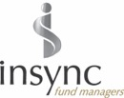











FGG fund managers
Notes:
Proven portfolio managers with a track record of strong performance.
Diverse portfolio of fund managers (13bn+ in FUM) and asset management companies (600bn+ AUM).
Varied investment strategies including long only, absolute return and quantitative funds.
Wholesale managers that are otherwise unavailable to retail investors
Closed funds that are otherwise unavailable to retail investors
Professional and experienced investment committee who will allocate funds and monitor the investments.

Slide 21








FGG charities

Slide 22










FGG service providers

Slide 23

FGG performance

Slide 24

FGG highlights
    $6.1m
    Profit before tax
    $3.2m
    Savings of management, performance & service fees
    $2.4m
    Donation to charities
    1.0
    Cent per share fully franked dividend

Slide 25
FGG performance
Performance at 31 October 2016 | 3 MONTH % | 6 MONTH % | 1 YEAR % | Since inception September 2015 %
FGG | -0.4% | 3.3% | -2.9% | -0. 9%
MSCI World Index (AUD) | -1.0% | 3.0% | -4.2% | -0.2%
Outperformance | +0.6% | +0.3% | +1.3% | -0.7%

Slide 26
FGG Net Tangible Assets as at 31 October 2016
NTA after tax
& before tax on unrealised gains
104.52c
NTA before tax
104.38c
NTA after tax
105.85c
*The above figures are not diluted for 272,489,814 options on issue with an exercise price of $1.10.

Slide 27
Investment strategy allocation
FGG Performance

Slide 28
Allocation at 31 October 2016
FGG Performance
Fund manager | Investment | Strategy | % of assets
Magellan Asset Management | Magellan Global Fund | Long equities | 10.0%
Ironbridge Capital Management | Ironbridge Global Focus Fund | Long equities | 9.7%
Cooper Investors | Cooper Investors Global Equities Fund (Unhedged) | Long equities | 8.6%
Antipodes Partners | Antipodes Global Fund | Absolute bias | 8.5%
VGI Partners | VGI Partners Funds | Absolute bias | 7.9%
Marsico Capital Management | Marsico Global Fund | Long equities | 7.0%
Nikko Asset Management Australia | Nikko AM Global Share Fund | Long equities | 6.0%
Manikay Partners | Manikay Global Opportunistic USD Fund | Absolute bias | 5.1%
Ellerston Capital | Ellerston Global Investments Wholesale Fund | Long equities | 4.9%
Morphic Asset Management | Morphic Global Opportunities Fund | Absolute bias | 4.5%
Neuberger Berman Australia | Neuberger Berman Systematic Global Equities Trust | Quantitative strategies | 3.8%
Paradice Investment Management | Paradice Global Small Mid Cap Fund Unhedged | Long equities | 3.5%
Cooper Investors | Cooper Investors Asian Tiger Fund | Long equities | 3.4%
Antipodes Partners | Antipodes Asia Fund | Absolute bias | 2.8%
Tribeca Investment Partners | Tribeca Global Total Return Fund | Quantitative strategies | 2.6%
Avenir Capital | Avenir Value Fund | Absolute bias | 1.8%
Hunter Hall Investment Management | Hunter Hall Global Equities Trust | Long equities | 1.5%
Eastspring Investments (Singapore) | Eastspring Investments Asian Dynamic Fund | Absolute bias | 1.5%
Insync Funds Management | InSync Global Titans Fund | Long equities | 1.4%
 | Cash and Term Deposits | Cash | 5.9%

Slide 29
Contact us
E: info@futuregeninvest.com.au
T: (02) 9247 9202
F: (02) 9247 6855
www.futuregeninvest.com.au
Twitter: @FutureGenInvest
LinkedIn: Future Generation Investment Companies

